Slide 1



Business_insights_360
View in Power BI
Last data refresh:
8/9/2024 7:16:50 PM UTC
Downloaded at:
8/12/2024 8:09:27 PM UTC

Slide 2
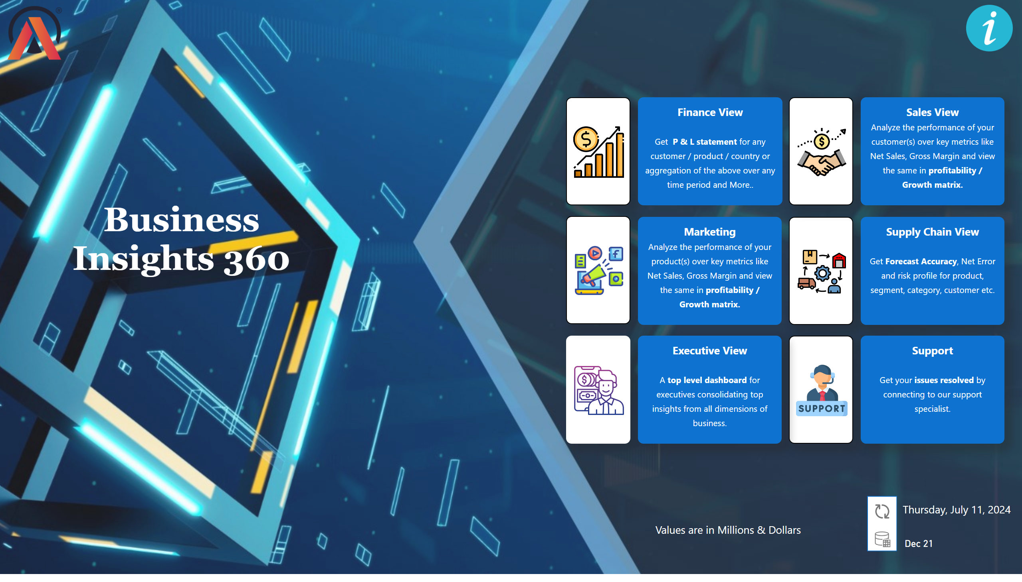
New Home
Notes:
image
No alt text provided
image
No alt text provided
image
No alt text provided
image
No alt text provided
image
No alt text provided
image
No alt text provided
image
No alt text provided
textbox
No alt text provided
textbox
No alt text provided
textbox
No alt text provided
textbox
No alt text provided
textbox
No alt text provided
textbox
No alt text provided
textbox
No alt text provided
textbox
No alt text provided
textbox
No alt text provided
textbox
No alt text provided
card
No alt text provided
shape
No alt text provided
image
No alt text provided
image
No alt text provided
cardVisual
No alt text provided
image
No alt text provided

Slide 3
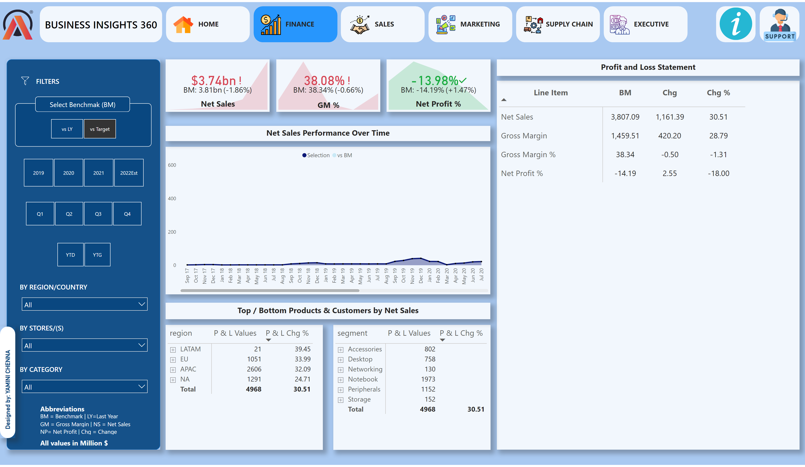
Finance View New
Notes:
shape
No alt text provided
shape
No alt text provided
image
No alt text provided
shape
No alt text provided
shape
No alt text provided
slicer
No alt text provided
slicer
No alt text provided
slicer
No alt text provided
slicer
No alt text provided
BY REGION/COUNTRY
No alt text provided
BY STORES/(S)
No alt text provided
BY CATEGORY
No alt text provided
shape
No alt text provided
shape
No alt text provided
shape
No alt text provided
shape
No alt text provided
shape
No alt text provided
AB Signature
No alt text provided
image
No alt text provided
shape
No alt text provided
shape
No alt text provided
shape
No alt text provided
shape
No alt text provided
shape
No alt text provided
shape
No alt text provided
image
No alt text provided
textbox
No alt text provided
image
No alt text provided
textbox
No alt text provided
textbox
No alt text provided
textbox
No alt text provided
textbox
No alt text provided
image
No alt text provided
image
No alt text provided
image
No alt text provided
shape
No alt text provided
image
No alt text provided
shape
No alt text provided
textbox
No alt text provided
kpi
No alt text provided
textbox
No alt text provided
kpi
No alt text provided
textbox
No alt text provided
kpi
No alt text provided
textbox
No alt text provided
pivotTable
No alt text provided
textbox
No alt text provided
Net Sales Performance Over Time
No alt text provided
pivotTable
No alt text provided
pivotTable
No alt text provided
card
No alt text provided
card
No alt text provided
image
No alt text provided
shape
No alt text provided
image
No alt text provided

Slide 4
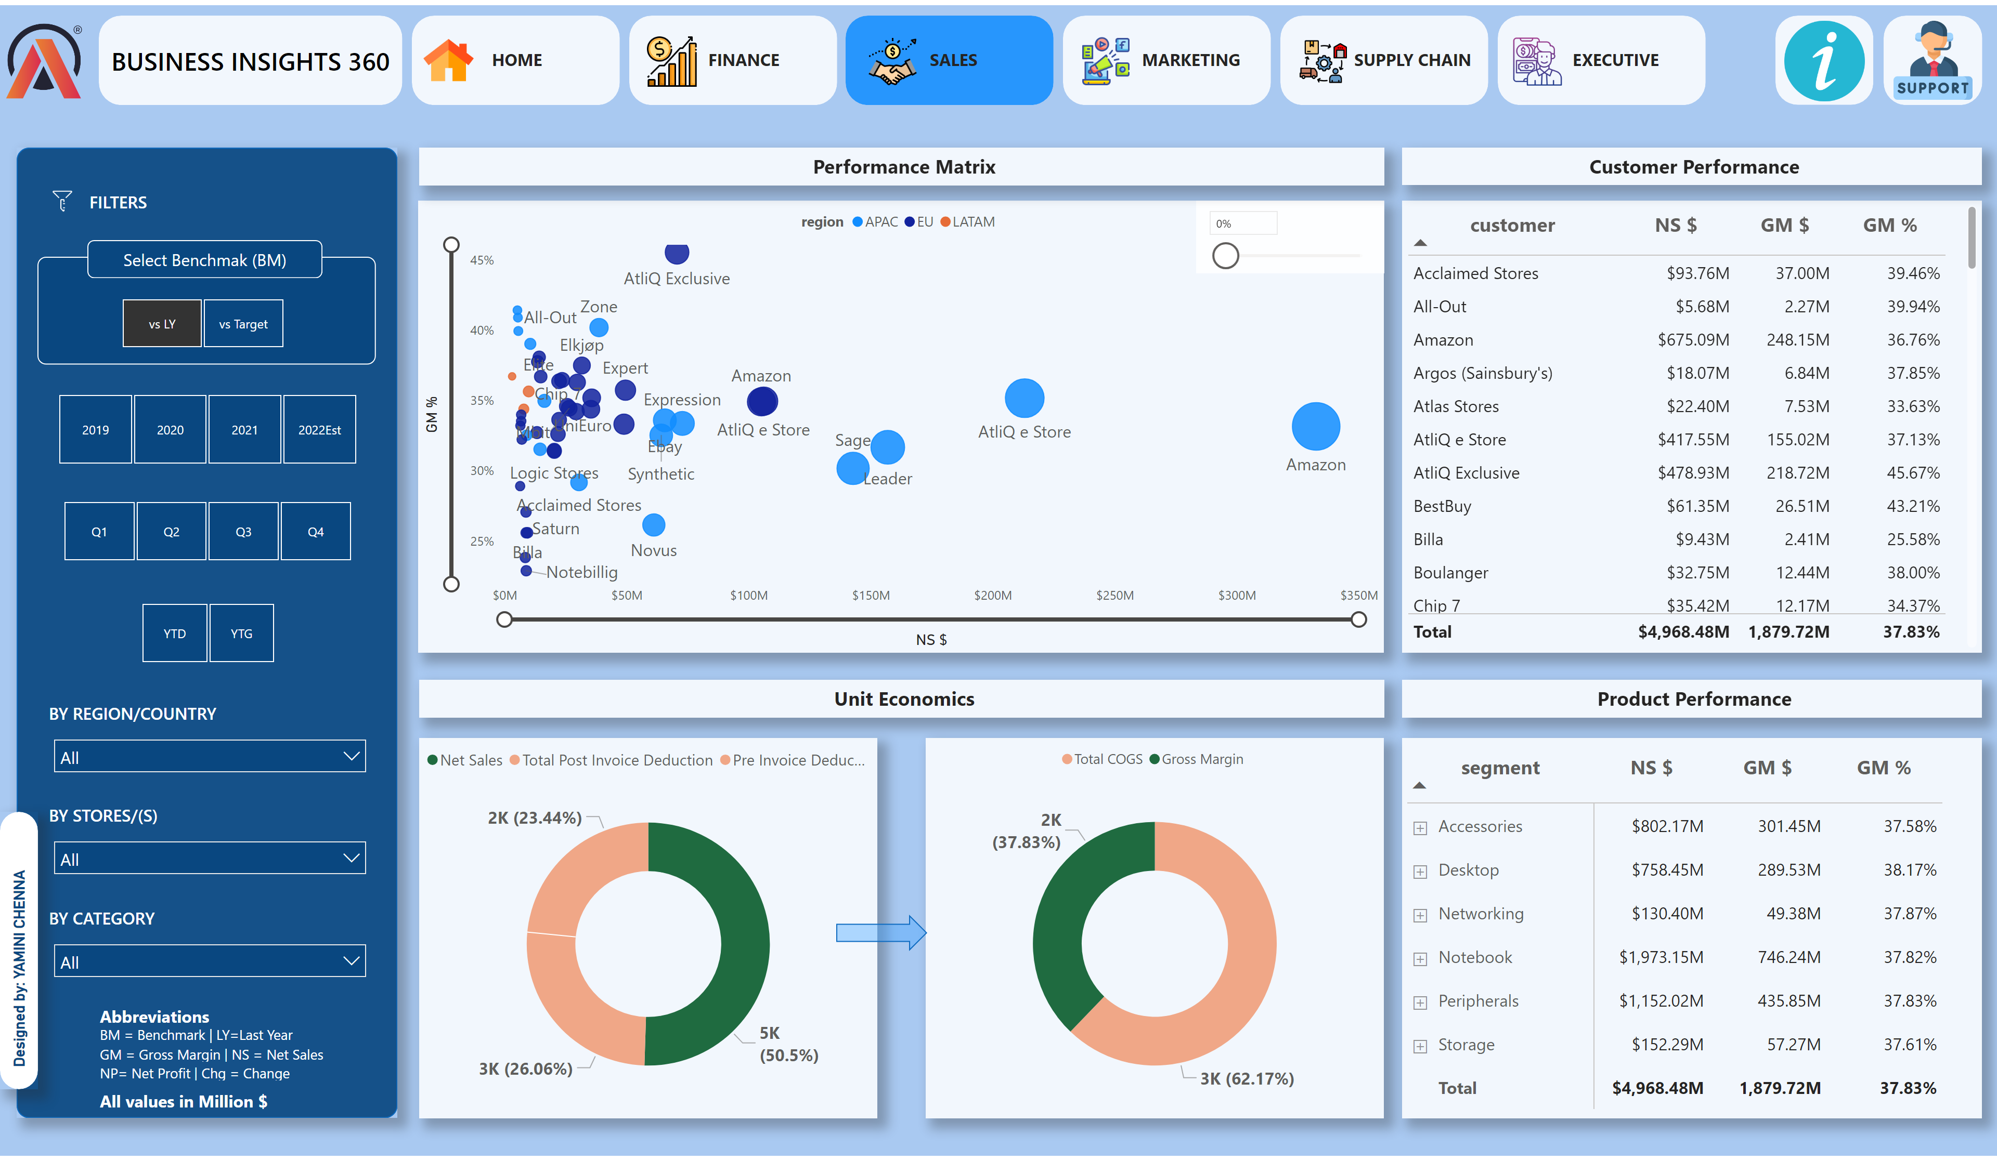
Sales View New
Notes:
shape
No alt text provided
shape
No alt text provided
image
No alt text provided
shape
No alt text provided
shape
No alt text provided
slicer
No alt text provided
slicer
No alt text provided
slicer
No alt text provided
slicer
No alt text provided
BY REGION/COUNTRY
No alt text provided
BY STORES/(S)
No alt text provided
BY CATEGORY
No alt text provided
shape
No alt text provided
shape
No alt text provided
shape
No alt text provided
shape
No alt text provided
shape
No alt text provided
AB Signature
No alt text provided
image
No alt text provided
shape
No alt text provided
shape
No alt text provided
shape
No alt text provided
shape
No alt text provided
shape
No alt text provided
shape
No alt text provided
image
No alt text provided
textbox
No alt text provided
image
No alt text provided
textbox
No alt text provided
textbox
No alt text provided
textbox
No alt text provided
textbox
No alt text provided
image
No alt text provided
image
No alt text provided
image
No alt text provided
shape
No alt text provided
image
No alt text provided
shape
No alt text provided
textbox
No alt text provided
scatterChart
No alt text provided
slicer
No alt text provided
textbox
No alt text provided
donutChart
No alt text provided
donutChart
No alt text provided
shape
No alt text provided
textbox
No alt text provided
tableEx
No alt text provided
textbox
No alt text provided
pivotTable
No alt text provided
textbox
No alt text provided
image
No alt text provided
shape
No alt text provided
image
No alt text provided

Slide 5
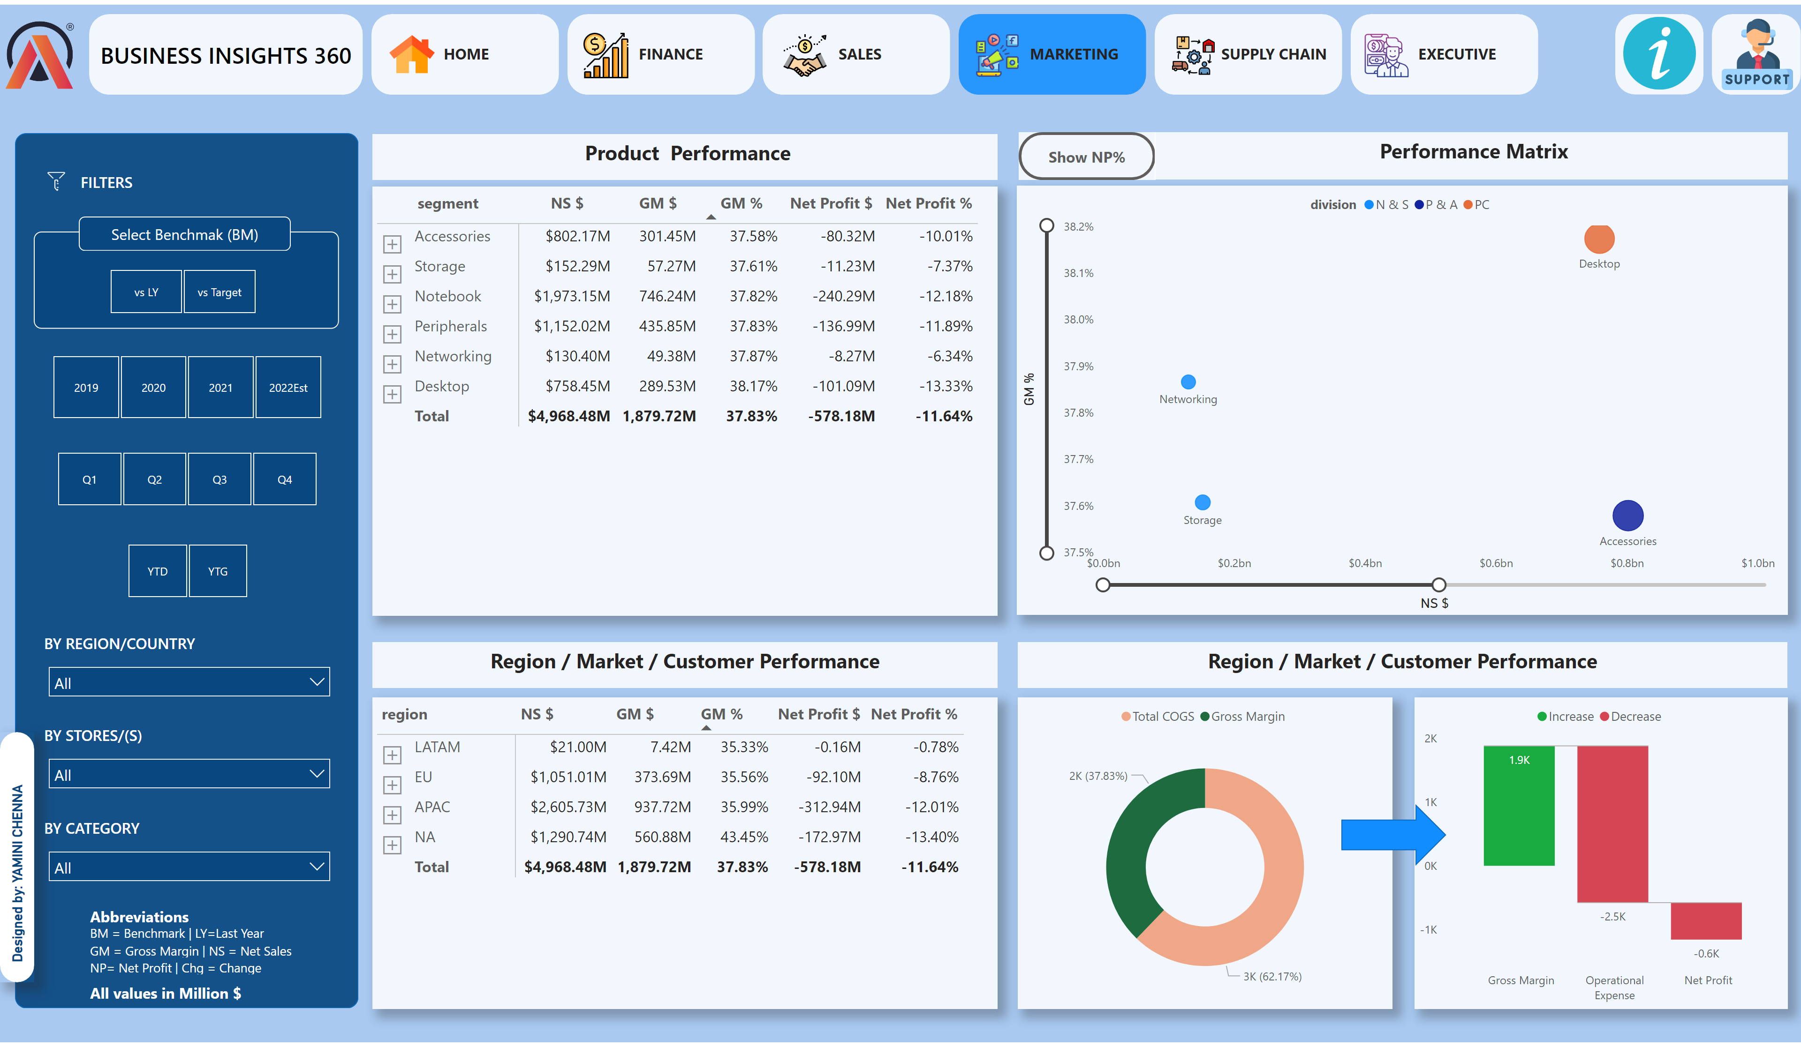
Marketing View New
Notes:
shape
No alt text provided
shape
No alt text provided
image
No alt text provided
shape
No alt text provided
shape
No alt text provided
slicer
No alt text provided
slicer
No alt text provided
slicer
No alt text provided
slicer
No alt text provided
BY REGION/COUNTRY
No alt text provided
BY STORES/(S)
No alt text provided
BY CATEGORY
No alt text provided
shape
No alt text provided
shape
No alt text provided
shape
No alt text provided
shape
No alt text provided
shape
No alt text provided
AB Signature
No alt text provided
image
No alt text provided
shape
No alt text provided
shape
No alt text provided
shape
No alt text provided
shape
No alt text provided
shape
No alt text provided
shape
No alt text provided
image
No alt text provided
textbox
No alt text provided
image
No alt text provided
textbox
No alt text provided
textbox
No alt text provided
textbox
No alt text provided
textbox
No alt text provided
image
No alt text provided
image
No alt text provided
image
No alt text provided
shape
No alt text provided
image
No alt text provided
shape
No alt text provided
textbox
No alt text provided
pivotTable
No alt text provided
pivotTable
No alt text provided
donutChart
No alt text provided
waterfallChart
No alt text provided
NP% Button
No alt text provided
GM % Visual
No alt text provided
actionButton
No alt text provided
scatterChart
No alt text provided
textbox
No alt text provided
textbox
No alt text provided
textbox
No alt text provided
textbox
No alt text provided
image
No alt text provided
shape
No alt text provided
image
No alt text provided
shape
No alt text provided

Slide 6
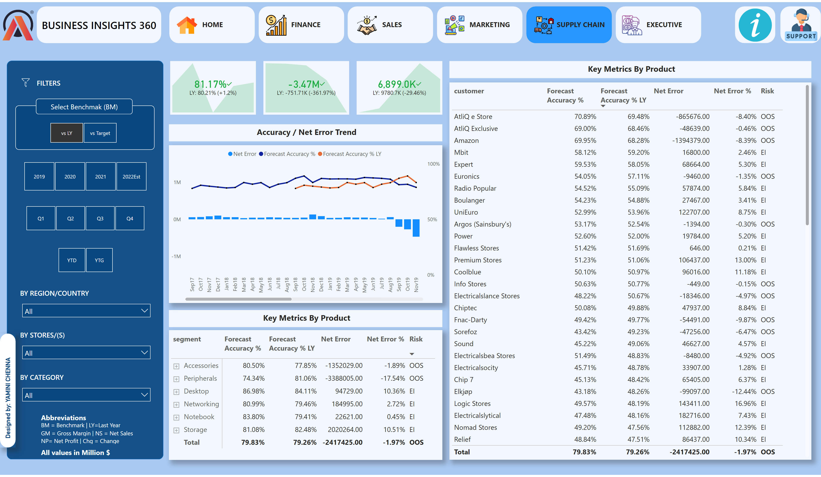
Supply Chain View New
Notes:
shape
No alt text provided
shape
No alt text provided
image
No alt text provided
shape
No alt text provided
shape
No alt text provided
slicer
No alt text provided
slicer
No alt text provided
slicer
No alt text provided
slicer
No alt text provided
BY REGION/COUNTRY
No alt text provided
BY STORES/(S)
No alt text provided
BY CATEGORY
No alt text provided
shape
No alt text provided
shape
No alt text provided
shape
No alt text provided
shape
No alt text provided
shape
No alt text provided
AB Signature
No alt text provided
image
No alt text provided
shape
No alt text provided
shape
No alt text provided
shape
No alt text provided
shape
No alt text provided
shape
No alt text provided
shape
No alt text provided
image
No alt text provided
textbox
No alt text provided
image
No alt text provided
textbox
No alt text provided
textbox
No alt text provided
textbox
No alt text provided
textbox
No alt text provided
image
No alt text provided
image
No alt text provided
image
No alt text provided
shape
No alt text provided
image
No alt text provided
shape
No alt text provided
textbox
No alt text provided
kpi
No alt text provided
kpi
No alt text provided
kpi
No alt text provided
lineClusteredColumnComboChart
No alt text provided
pivotTable
No alt text provided
tableEx
No alt text provided
textbox
No alt text provided
textbox
No alt text provided
textbox
No alt text provided
image
No alt text provided
shape
No alt text provided
image
No alt text provided

Slide 7
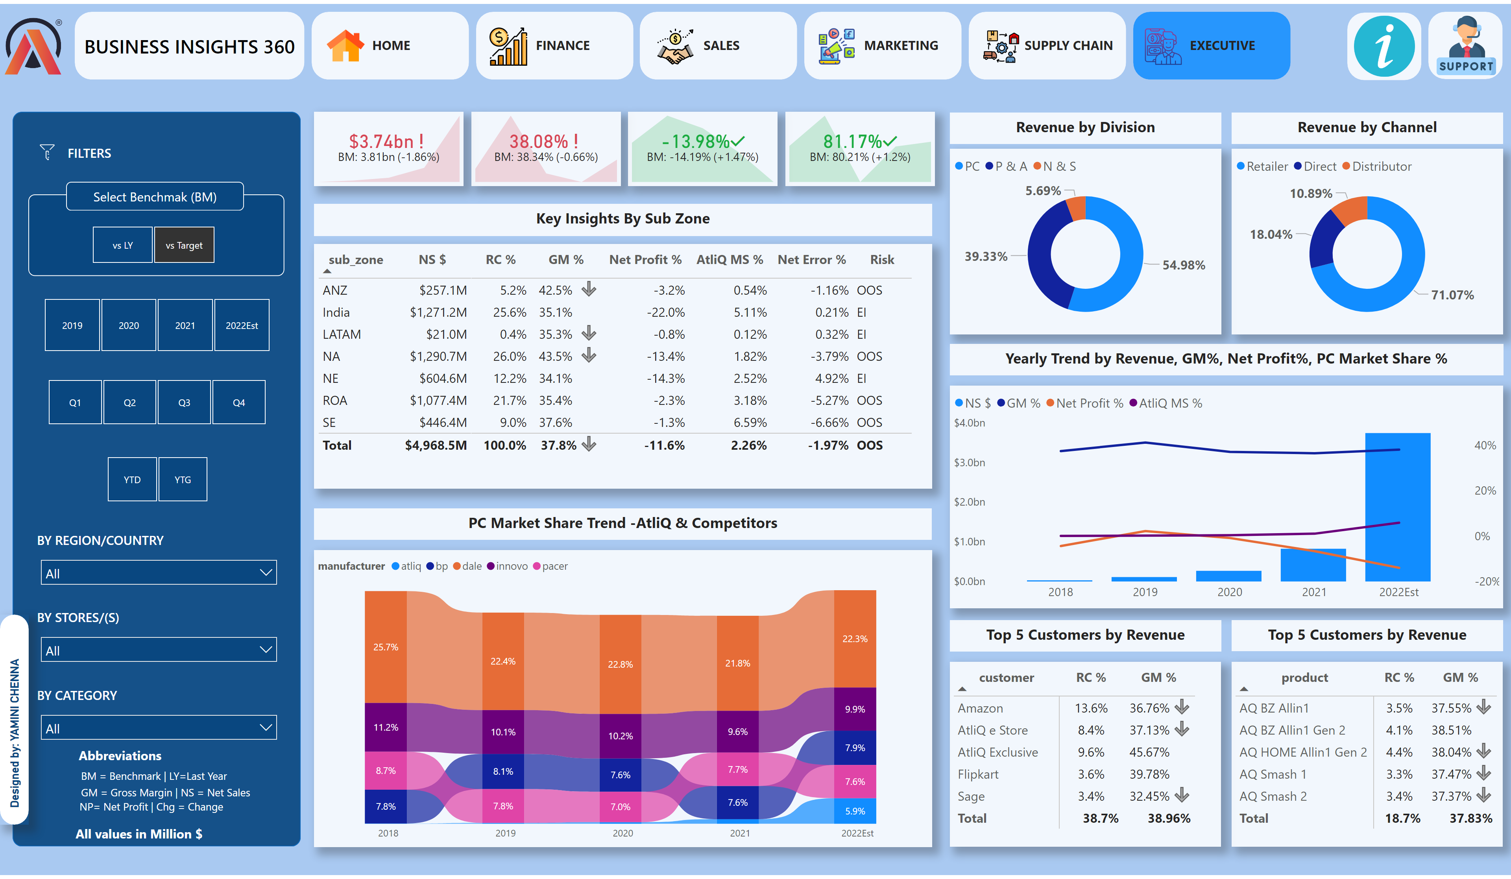
Executive View New
Notes:
shape
No alt text provided
shape
No alt text provided
image
No alt text provided
shape
No alt text provided
shape
No alt text provided
slicer
No alt text provided
slicer
No alt text provided
slicer
No alt text provided
slicer
No alt text provided
BY REGION/COUNTRY
No alt text provided
BY STORES/(S)
No alt text provided
BY CATEGORY
No alt text provided
shape
No alt text provided
shape
No alt text provided
shape
No alt text provided
shape
No alt text provided
shape
No alt text provided
AB Signature
No alt text provided
image
No alt text provided
shape
No alt text provided
shape
No alt text provided
shape
No alt text provided
shape
No alt text provided
shape
No alt text provided
shape
No alt text provided
image
No alt text provided
textbox
No alt text provided
image
No alt text provided
textbox
No alt text provided
textbox
No alt text provided
textbox
No alt text provided
textbox
No alt text provided
image
No alt text provided
image
No alt text provided
image
No alt text provided
shape
No alt text provided
image
No alt text provided
shape
No alt text provided
textbox
No alt text provided
kpi
No alt text provided
kpi
No alt text provided
kpi
No alt text provided
kpi
No alt text provided
donutChart
No alt text provided
donutChart
No alt text provided
lineStackedColumnComboChart
No alt text provided
pivotTable
No alt text provided
pivotTable
No alt text provided
tableEx
No alt text provided
ribbonChart
No alt text provided
textbox
No alt text provided
textbox
No alt text provided
textbox
No alt text provided
textbox
No alt text provided
textbox
No alt text provided
textbox
No alt text provided
textbox
No alt text provided
image
No alt text provided
shape
No alt text provided
image
No alt text provided

Slide 8
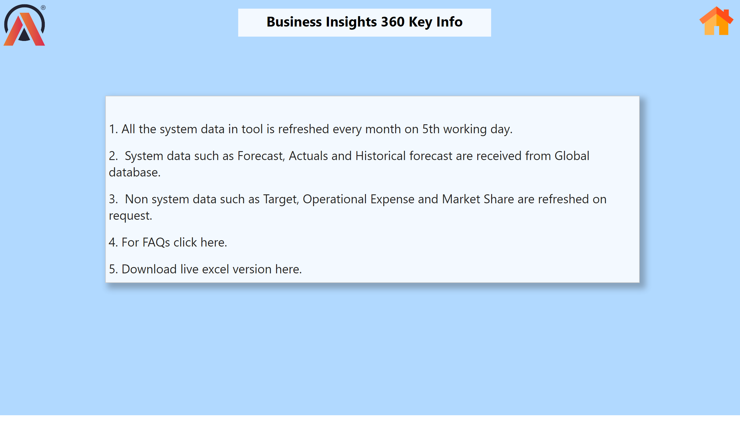
Info
Notes:
textbox
No alt text provided
textbox
No alt text provided
image
No alt text provided
image
No alt text provided

Slide 9
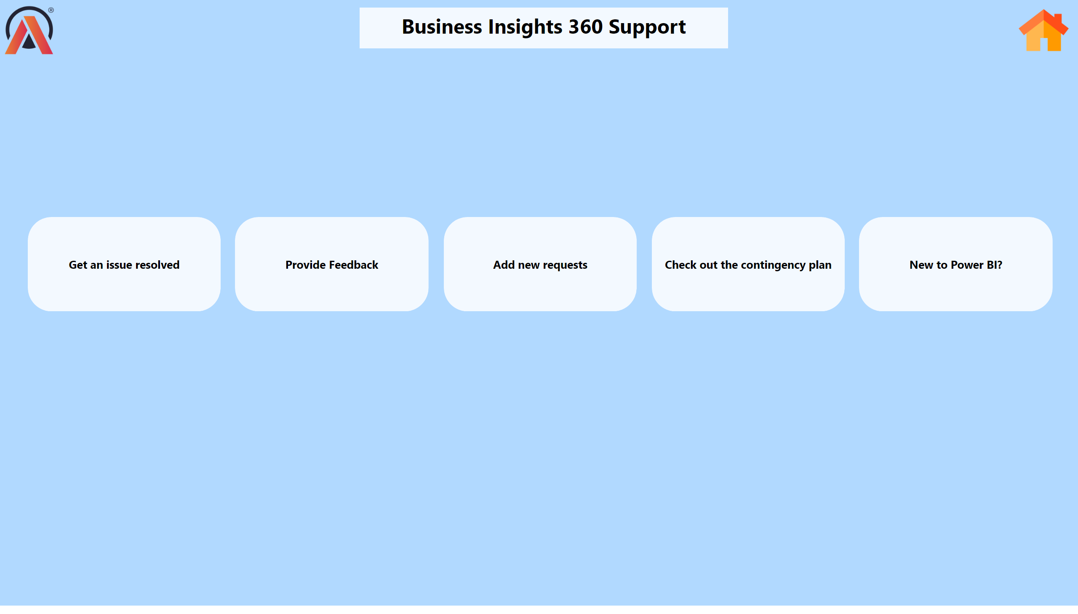
Support
Notes:
textbox
No alt text provided
image
No alt text provided
shape
No alt text provided
shape
No alt text provided
shape
No alt text provided
shape
No alt text provided
shape
No alt text provided
image
No alt text provided

